Slide 1
LaTeX
A primer

Slide 2



House Rules
No such thing as a silly question…
… so ask me at any point…
…but I may park questions for later

Slide 3
Welcome to LaTeX
Introduction to the language
File and project structure
Writing commands
Formatting text
Text modifiers
Punctuation
Lists
Structuring documents
Document classes
Document sections and blocks
Writing mathematics
Simple mathematical blocks
Equations
Mathematical characters
Using figures
Using images
Image operations
LaTeX figures
Positioning figures

Slide 4
Preamble
\documentclass[papersize, fontsize]{class}
article | report | book
\title{title}
\author{author}
\date{\today}
\usepackage{setspace}
\spacing{1.6} %doublespace
% article – papers
% report – chaptered document
% book – for a book or thesis structure
%papersize: often a3paper, a4paper…
\usepackage{amsmath} %maths
\usepackage{amssymb} %maths symbols
\usepackage{graphicx}
\graphicspath{ {figures/} }
\DeclareGraphicsExtensions{.png,.pdf}
Main Body
\begin{document}
\maketitle
Typed text is as written
\textbf{bold}, \textit{italic}, \textsuperscript{s^{uper}}, \textsubscript{s_{ub}}, \textsc{SmallCaps}, \underline{ul}
` or `` to start quotes
\textendash \textemdash
tiny, scriptsize, footnotesize, small, normalsize, large, Large, LARGE, huge, Huge
\begin{flushleft} {center} {flushright}
\end{…}
\begin{itemize|enumerate|description}[A.][i.] %lettered/roman
\item bullet or numbered item
\item[label] for description item
\begin{part|chapter|abstract}
\section{name} \subsection{} \subsubsection{} \paragraph{} \subparagraph{}
\includegraphics[width|height|scale|angle|clip]{filename}
\begin{figure}[position]
\centering
\includegraphics[]{}…
\caption{caption text}
\end{figure}
\end{document}
Non-Textual
\command[options]{context}
#, $, %, ^, &, _, {, }, ~, \ are reserved
Multiple consecutive spaces = one space
2+ consecutive newlines = new paragraph
This is $inline$ maths
$$block maths$$
\begin{equation}
equation
\end{equation}
^{maths superscript}
_{maths subscript}
“\ “ – maths whitespace
\left( \left[ \left{ \right)}]…
image units: \textwidth \columnwidth mm pt cm em…
\includegraphics[clip=true, trim left bot right top]{imagepath}
\includegraphics[angle=45]{imagepath}
\setlength\fboxrule{2pt} %border thickness
\fbox{includegraphics…}
[h|t|b|p|!|H] – here, top, bottom, own page, override!, HERE!

Slide 5
LaTeX - A Typesetting Language
Lampert’s TeX
Released in 1989
Based on the core TeX system (ΤεΧ)
Extends the functionality of TeX with an extended framework
Although technically Turing-complete, is not intended as a programming language

Slide 6
Word Processors and Typesetters
Word Processor
Typesetting Language
WYSIWYG
Menu-controlled layout
Managing layout and content at the same time
Cascading formatting changes
Implicit formatting
Large file footprint
Limited special character support
Source code
Code-controlled layout
Content and layout are programmatically separated
Insulated format changes
Explicit formatting
Small core code footprint
Extensive special character support

Slide 7
Why Typesetters?
Separate content creation and layout management
Formatting is more consistent and harder to break
Managing larger documents is much easier and faster
Equations and scientific notations are easier
Referencing and in-document links are much easier and automatable

Slide 8
Getting started
www.overleaf.com

Slide 9
Resources
GitHub
https://www.overleaf.com/learn
https://TeX.stackexchange.com/
https://www.overleaf.com/learn/latex/Errors

Slide 10
Hierarchy of a LaTeX project
Main Directory
Main .TeX file
Chapter directories
Chapter .TeX files
Figures
Images
.bibtex
Generated .pdf
Figures
Bibliography

Slide 11
Structure of a document
Preamble
Document Metadata
Author
Document Name
Document Layout
Packages
Body
Document Content
Bibliography
.TeX document

Slide 12
\documentclass[format]{class}
Preamble
\begin{document}
Main body
\end{document}

Slide 13
\documentclass[a4paper]{report}
\title{example title}
\author{Richard}
\date{\today}
\begin{document}
\maketitle
This is my \textit{example} document
\end{document}

Slide 14




Slide 19
Preamble
\documentclass[papersize, fontsize]{class}
article | report | book
\title{title}
\author{author}
\date{\today}
Main Body
\begin{document}
\maketitle
Typed text is as written
\end{document}
Non-Textual

Slide 20
Commands \command[options]{context}
Always start with a “\”
May be stand-alone, or need extra information
Control the document structure, formatting, equations, citations, images etc…
If it isn’t just displaying simple text, you’ll do it with a \command

Slide 21
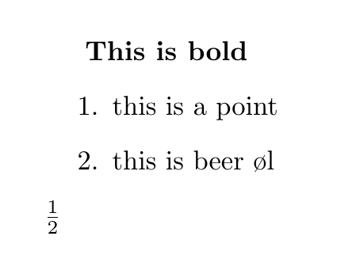
Command complexity
\documentclass[a4paper]{report}
\begin{document}
\textbf{This is bold}
\begin{enumerate}
\item this is a point
\item this is beer \o l
\end{enumerate}
$\frac{1}{2}$
%this is a comment
\end{document}

Slide 22
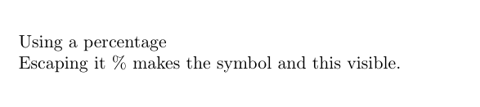
Reserved characters
# $ % ^ & _ { } ~ \
These mean something to LaTeX and are reserved – if you need to use them you can use “\” to escape the character and let LaTeX read it literally.
Using a percentage % makes this a comment
Escaping it \% makes the symbol and this visible.

Slide 23
Reserved characters
#
$
%
^
&
_
{}
~
\
Macro parameter
Maths mode
Comment
Maths superscript
Alignment character
Maths subscript
Processing block
Unbreakable space
Command character

Slide 24
Whitespace and returns
In text mode, one or more consecutive spaces and tabs (aka “whitespace”) are treated are a single space.
Whitespace at the beginning of a line is ignored
One or more empty lines between text (two or more returns) are treated as a paragraph break.
You can have a new line per sentence in a paragraph without issue
These rules vary slightly in maths mode

Slide 25
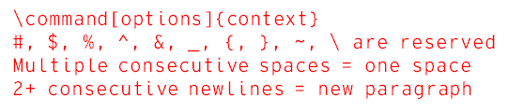
Preamble
\documentclass[papersize, fontsize]{class}
article | report | book
\title{title}
\author{author}
\date{\today}
Main Body
\begin{document}
\maketitle
Typed text is as written
\end{document}
Non-Textual

Slide 26
Formatting text
Changing text attributes and layout within a textual setting

Slide 27
Text modifiers
Bold
Italics
S^{uperscript}
S_{ubscript}
Size
Punctuation marks … - `` “
Small Caps
Underlined
San serif font
Typewriter font
Serif font
Colour

Slide 28
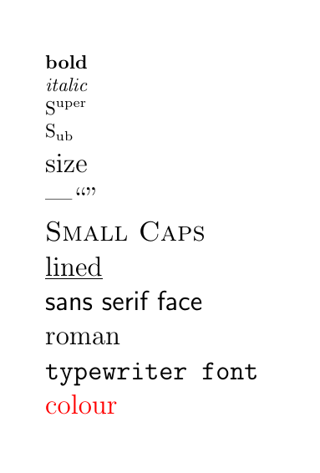
Text modifiers
\textbf{bold}
\textit{italic}
S\textsuperscript{uper}
S\textsubscript{ub}
\Large{size}
\textemdash ``”
\textsc{Small Caps}
\underline{lined}
\textsf{sans serif face}
\textrf{roman / serif face}
\texttt{typewriter font}
\textcolor{red}{colour}

Slide 29
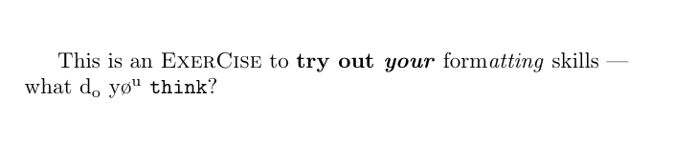
Give it a go
Replicate the following passage:

Slide 30
\documentclass[a4paper]{report}
\begin{document}
This is an \textsc{ExerCise} to \textbf{try out \textit{your}} form\textit{atting} skills \textemdash \\what d\textsubscript{o} y\o \textsuperscript{u} \texttt{thin\textbf{k}}?
\end{document}

Slide 31

Punctuation - quotations
Not all quotation marks are created equal
‘single’ quotations and “double quotations”
‘ “ starting quotations
Ending quotations ” ’
For opening quotes use `
`single’ and ``double”

Slide 32
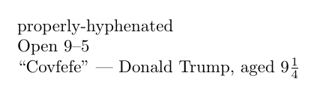
Punctuation - dashes
Not all dashes are created equal
Hyphens are used to join two words together like-this
“en” dashes are used to span numbers or categories together: 1939 – 1945
“em” dashes are used in the place of parentheses or for attribution.
-
\textendash
\textemdash

Slide 33
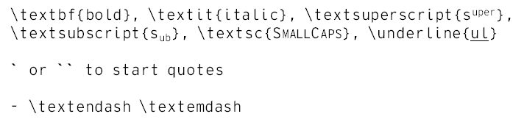
Preamble
\documentclass[papersize, fontsize]{class}
article | report | book
\title{title}
\author{author}
\date{\today}
Main Body
\begin{document}
\maketitle
Typed text is as written
\end{document}
Non-Textual
\command[options]{context}
#, $, %, ^, &, _, {, }, ~, \ are reserved
Multiple consecutive spaces = one space
2+ consecutive newlines = new paragraph

Slide 34
Font size
The default size can be specified in the preamble
\documentclass[12pt]{report}
Deviations to the size can be defined in the main body:
\<size>{text}
Headings, Titles and subsections are handled differently

Slide 35
Font sizes
\tiny{}
\scriptsize{}
\footnotesize{}
\small{}
\normalsize{}
\large{}
\Large{}
\LARGE{}
\huge{}
\Huge{}

Slide 36
Text Alignment
Text is justified by default. You can deviate from default style with main body commands
\begin{flushleft}…\end{flushright}
\begin{flushright}…\end{flushright}
\begin{center}…\end{center}

Slide 37
Text spacing
Default can be set in the preamble using:
\usepackage{setspace}
\spacing{1|1.5|2}
You can deviate from the style with commands in the main body with:
\begin{spacing}{<size>}…\end{spacing}

Slide 38

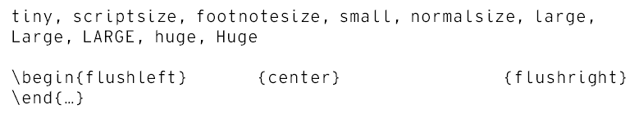
Preamble
\documentclass[papersize, fontsize]{class}
article | report | book
\title{title}
\author{author}
\date{\today}
Main Body
\begin{document}
\maketitle
Typed text is as written
\textbf{bold}, \textit{italic}, \textsuperscript{s^{uper}}, \textsubscript{s_{ub}}, \textsc{SmallCaps}, \underline{ul}
` or `` to start quotes
\textendash \textemdash
\end{document}
Non-Textual
\command[options]{context}
#, $, %, ^, &, _, {, }, ~, \ are reserved
Multiple consecutive spaces = one space
2+ consecutive newlines = new paragraph

Slide 39
Lists
Itemize
Bullet point/Unnumbered list
\begin{itemize}
\item …
\item …
\end{itemize}
Enumerate
Numbered list
\begin{enumerate}
\item …
\item …
\end{enumerate}

Slide 40
Variations on lists
Making enumerates alphabetic/roman:
\begin{enumerate}[A.]|[i.]
Description lists with labels, not points:
\begin{description}
\item[label] …

Slide 41

Preamble
\documentclass[papersize, fontsize]{class}
article | report | book
\title{title}
\author{author}
\date{\today}
\usepackage{setspace}
\spacing{1.6} %doublespace
Main Body
\begin{document}
\maketitle
Typed text is as written
\textbf{bold}, \textit{italic}, \textsuperscript{s^{uper}}, \textsubscript{s_{ub}}, \textsc{SmallCaps}, \underline{ul}
` or `` to start quotes
\textendash \textemdash
tiny, scriptsize, footnotesize, small, normalsize, large, Large, LARGE, huge, Huge
\begin{flushleft} {center} {flushright}
\end{…}
\end{document}
Non-Textual
\command[options]{context}
#, $, %, ^, &, _, {, }, ~, \ are reserved
Multiple consecutive spaces = one space
2+ consecutive newlines = new paragraph

Slide 42
Structuring documents

Slide 43
Specifying document types \documentclass[paper type, text size]{document type}
Article – ideal for papers
Report – ideal for larger reports. Can have chapters
Book – Ideal for theses.
Paper types are typically “axpaper” – e.g. a3paper, a4paper…

Slide 44
Chapters and sections
Excluding document, each structural element follows the \<element>{title} pattern
Document
Abstract
Chapter
Section
Subsection
Subsubsection
Paragraph
Subparagraph
Part
Title

Slide 45
Class elements and numbering
Elements | Article | Report | Book
Abstract | Yes | Yes
Part | Yes | Yes | Yes
Chapter |  | 1 | 1
Section | 1 | 0.1 | 0.1
Subsection | 0.1 | 0.0.1 | 0.0.1
Subsubsection | 0.0.1 | Yes | Yes
Paragraph | Yes | Yes | Yes
subparagraph | Yes | Yes | Yes

Slide 46

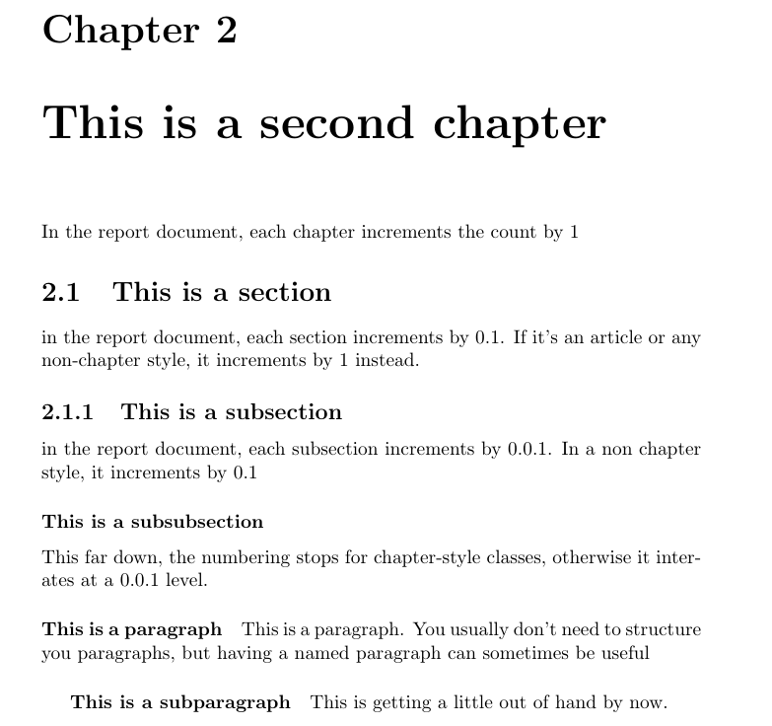


Exercise: sections

Slide 47
Exercise: sections
\documentclass[a4paper]{report}
\author{Au Thour}
\title{This is a report title}
\begin{document}
\maketitle
\begin{abstract}
This is an abstract
\end{abstract}
\chapter{This is a blank chapter}
\chapter{This is a second chapter}
In the report document, each chapter increments the count by 1
\section{This is a section}
in the report document, each section increments by 0.1. If it's an article or any non-chapter style, it increments by 1 instead.
\subsection{This is a subsection}
in the report document, each subsection increments by 0.0.1. In a non chapter style, it increments by 0.1
\subsubsection{This is a subsubsection}
This far down, the numbering stops for chapter-style classes, otherwise it iterates at a 0.0.1 level.
\paragraph{This is a paragraph}
This is a paragraph. You usually don't need to structure you paragraphs, but having a named paragraph can sometimes be useful
\subparagraph{This is a subparagraph}
This is getting a little out of hand by now.
\end{document}

Slide 48
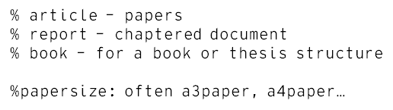

Preamble
\documentclass[papersize, fontsize]{class}
article | report | book
\title{title}
\author{author}
\date{\today}
\usepackage{setspace}
\spacing{1.6} %doublespace
Main Body
\begin{document}
\maketitle
Typed text is as written
\textbf{bold}, \textit{italic}, \textsuperscript{s^{uper}}, \textsubscript{s_{ub}}, \textsc{SmallCaps}, \underline{ul}
` or `` to start quotes
\textendash \textemdash
tiny, scriptsize, footnotesize, small, normalsize, large, Large, LARGE, huge, Huge
\begin{flushleft} {center} {flushright}
\end{…}
\begin{itemize|enumerate|description}[A.][i.] %lettered/roman
\item bullet or numbered item
\item[label] for description item
\end{document}
Non-Textual
\command[options]{context}
#, $, %, ^, &, _, {, }, ~, \ are reserved
Multiple consecutive spaces = one space
2+ consecutive newlines = new paragraph

Slide 49
Additional document elements: TOC
Table of contents: automatically populates depending on your chapters/sections/subsections.
In your main body, use \tableofcontents
Uses section titles to populate the text. Auto-updates the page numbers.
If the section title is too long/wrong for the ToC, create an alias:
\section[short toc name]{longer unwieldy title}
To hide a section from the ToC and unnumber it, use an asterisk:
\section*{title}

Slide 50
Mathematics

Slide 51
Maths mode
Latex allows you to typeset complex mathematical and technical notation, in addition to bodies of text
Maths can be types with inline and display blocks of maths, and even fully defined equations.
The $ symbol is used to demarcate blocks of maths
Same command structure in the mathematical mode, but the commands differ
Whitespace behaves differently – expecting equations not words

Slide 52
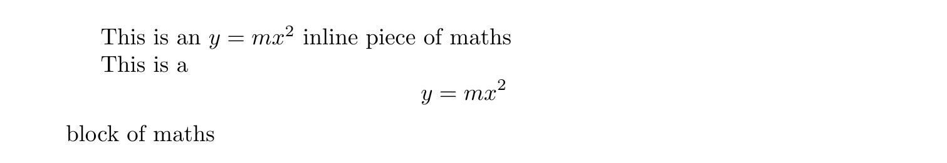
Inline and block maths
This is an $y = mx^2$ inline piece of maths
This is a $$y = mx^2$$block of maths

Slide 53
Maths packages
\usepackage{amsmath}
\usepackage{amssymb}
Neatens up more complicated mathematical typography and supports a wider ranges of textual and mathematical symbols
To be used in the preamble

Slide 54
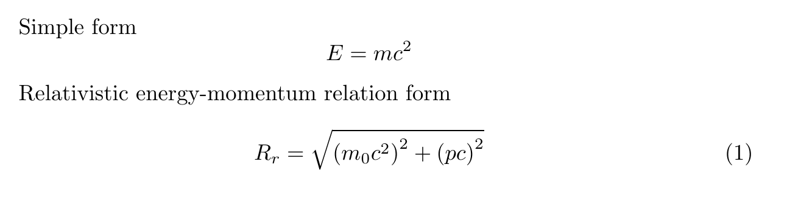
Equations
Simple form
$$E=mc^2$$
Relativistic energy-momentum relation form
\begin{equation}
R_r = \sqrt{\left( m_0c^2 \right)^2 + \left( pc \right)^2}
\end{equation}

Slide 55

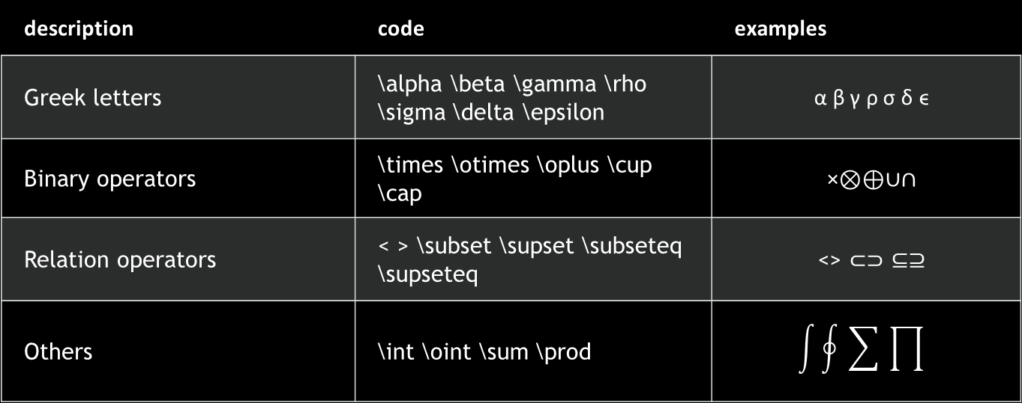
Common commands
description | code | examples
Greek letters | \alpha \beta \gamma \rho \sigma \delta \epsilon | α β γ ρ σ δ ϵ
Binary operators | \times \otimes \oplus \cup \cap | ×⊗⊕∪∩
Relation operators | < > \subset \supset \subseteq \supseteq | <> ⊂⊃ ⊆⊇
Others | \int \oint \sum \prod

Slide 56
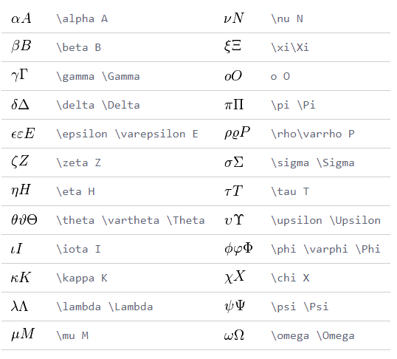
Further symbols
Greek Letters

Slide 57
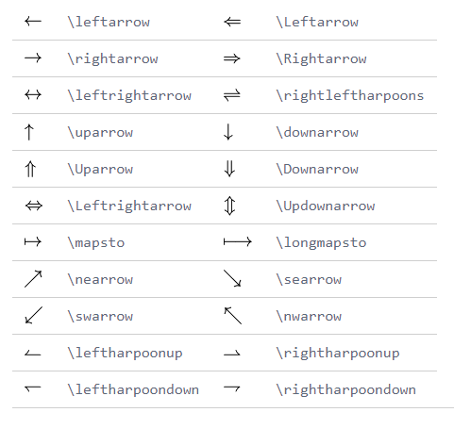
Further symbols
Arrows

Slide 58
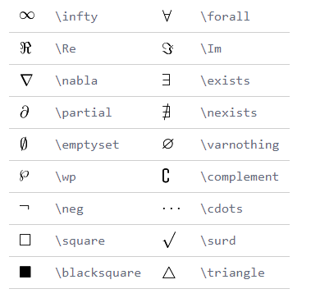
Further symbols
Common

Slide 59
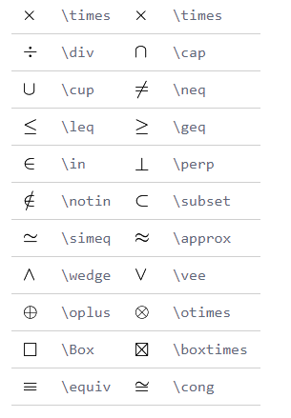
Further symbols
Binary|Operation

Slide 60
Even more symbols
http://www.rpi.edu/dept/arc/training/latex/LaTeX_symbols.pdf
“The great big list of LaTeX symbols”

Slide 61
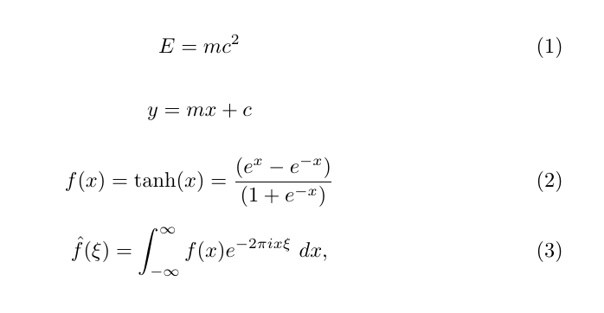
Exercise

Slide 62
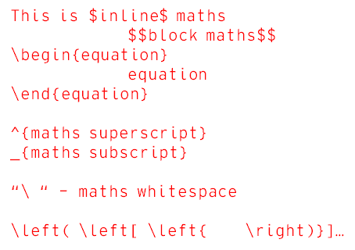

Preamble
\documentclass[papersize, fontsize]{class}
article | report | book
\title{title}
\author{author}
\date{\today}
\usepackage{setspace}
\spacing{1.6} %doublespace
% article – papers
% report – chaptered document
% book – for a book or thesis structure
%papersize: often a3paper, a4paper…
Main Body
\begin{document}
\maketitle
Typed text is as written
\textbf{bold}, \textit{italic}, \textsuperscript{s^{uper}}, \textsubscript{s_{ub}}, \textsc{SmallCaps}, \underline{ul}
` or `` to start quotes
\textendash \textemdash
tiny, scriptsize, footnotesize, small, normalsize, large, Large, LARGE, huge, Huge
\begin{flushleft} {center} {flushright}
\end{…}
\begin{itemize|enumerate|description}[A.][i.] %lettered/roman
\item bullet or numbered item
\item[label] for description item
\begin{part|chapter|abstract}
\section{name} \subsection{} \subsubsection{} \paragraph{} \subparagraph{}
\end{document}
Non-Textual
\command[options]{context}
#, $, %, ^, &, _, {, }, ~, \ are reserved
Multiple consecutive spaces = one space
2+ consecutive newlines = new paragraph

Slide 63
Figures

Slide 64
Graphics packages
Preamble
\usepackage{graphicx}
\graphicspath{ {figures/} }
Body
\includegraphics[detail]{filename}

Slide 65
Graphics paths
The graphics path specified should be relative.
The \graphicspath{ {figures/} } figure sets the automatic path for graphics to a subfolder “figures”.
A file extension isn’t needed, and it might be better to skip it – LaTeX will find all the matching files with the same name.
You can specify the extension preference order with \DeclareGraphicsExtensions{.png,.pdf}
This allows draft runs to use low res .pngs, and only use high-res pdfs if no png is available. For final versions, you can invert the order.

Slide 66
Image formats in LaTeX
JPG: Useful for including photos
PNG: Best choice for low-memory images and non-vector diagrams
PDF: Can be used to hold both bitmap and vector images. Better for vectors.
EPS: Ideal vector format, but can be slower to use.

Slide 67
Image size
\includegraphics[details]{relative imagepath}
[width=amount<unit>]
[height=amount<unit>]
If you only specify one dimension, the others will auto-scale to keep the same resolution
[scale=x] %scales the original image by the scale factor x
%2 is double original size, 0.5 is half

Slide 68
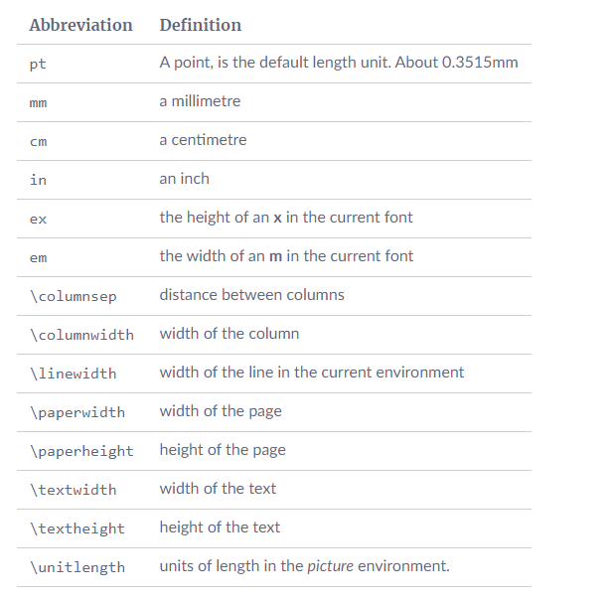
Units
If in doubt, use fractions of the dynamic sizes (e.g. textwidth)
[width=0.5\textwidth]

Slide 69
Further image manipulation
Clipping
\includegraphics[clip=true, trim 2mm 3mm 4mm 1mm]{imagepath}
The order is: left, bottom, right, top
Rotation
\includegraphics[angle=45]{imagepath}
Borders
\fbox{\includegraphics…}
Border Thickness
\setlength\fboxrule{2pt}
\fbox{includegraphics…}

Slide 70

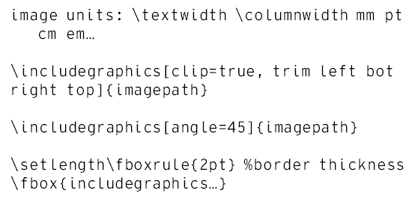
Preamble
\documentclass[papersize, fontsize]{class}
article | report | book
\title{title}
\author{author}
\date{\today}
\usepackage{setspace}
\spacing{1.6} %doublespace
% article – papers
% report – chaptered document
% book – for a book or thesis structure
%papersize: often a3paper, a4paper…
\usepackage{amsmath} %maths
\usepackage{amssymb} %maths symbols
Main Body
\begin{document}
\maketitle
Typed text is as written
\textbf{bold}, \textit{italic}, \textsuperscript{s^{uper}}, \textsubscript{s_{ub}}, \textsc{SmallCaps}, \underline{ul}
` or `` to start quotes
\textendash \textemdash
tiny, scriptsize, footnotesize, small, normalsize, large, Large, LARGE, huge, Huge
\begin{flushleft} {center} {flushright}
\end{…}
\begin{itemize|enumerate|description}[A.][i.] %lettered/roman
\item bullet or numbered item
\item[label] for description item
\begin{part|chapter|abstract}
\section{name} \subsection{} \subsubsection{} \paragraph{} \subparagraph{}
\end{document}
Non-Textual
\command[options]{context}
#, $, %, ^, &, _, {, }, ~, \ are reserved
Multiple consecutive spaces = one space
2+ consecutive newlines = new paragraph
This is $inline$ maths
$$block maths$$
\begin{equation}
equation
\end{equation}
^{maths superscript}
_{maths subscript}
“\ “ – maths whitespace
\left( \left[ \left{ \right)}]…

Slide 71
Images as figures
Figures are an environment that can encapsulate images, and text.
\equation is a better and purpose-built version of a figure for maths
the \tables environment is better suited for tables; both can use similar positioning logic.
They usually involve an image and a caption, and contain information about where in the page and document it should reside.
These content-encapsulating environments are one of the more powerful features in LaTeX

Slide 72
Figure environments
\begin{figure}[position]
\centering
\includegraphics…
\caption{caption text}
\end{figure}
Figures “float” around the document. LaTeX internally weighs the costs of breaking lines, sentences, paragraphs… when placing the figures in the best place possible. The position argument gives hints to where you would prefer the figure to appear.

Slide 73
Positioning
h – here: place the figure approximately here
t – top: place the figure at the top of the page
b – bottom: place the figure at the bottom page
p – page: place it on a separate for floats
! – override: any argument with ! to override internal hidden parameters
H – Here!: similar to h!, places a figure exactly at its location in the text.

Slide 74
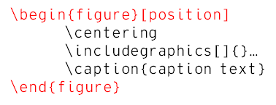

Preamble
\documentclass[papersize, fontsize]{class}
article | report | book
\title{title}
\author{author}
\date{\today}
\usepackage{setspace}
\spacing{1.6} %doublespace
% article – papers
% report – chaptered document
% book – for a book or thesis structure
%papersize: often a3paper, a4paper…
\usepackage{amsmath} %maths
\usepackage{amssymb} %maths symbols
\usepackage{graphicx}
\graphicspath{ {figures/} }
\DeclareGraphicsExtensions{.png,.pdf}
Main Body
\begin{document}
\maketitle
Typed text is as written
\textbf{bold}, \textit{italic}, \textsuperscript{s^{uper}}, \textsubscript{s_{ub}}, \textsc{SmallCaps}, \underline{ul}
` or `` to start quotes
\textendash \textemdash
tiny, scriptsize, footnotesize, small, normalsize, large, Large, LARGE, huge, Huge
\begin{flushleft} {center} {flushright}
\end{…}
\begin{itemize|enumerate|description}[A.][i.] %lettered/roman
\item bullet or numbered item
\item[label] for description item
\begin{part|chapter|abstract}
\section{name} \subsection{} \subsubsection{} \paragraph{} \subparagraph{}
\includegraphics[width|height|scale|angle|clip]{filename}
\end{document}
Non-Textual
\command[options]{context}
#, $, %, ^, &, _, {, }, ~, \ are reserved
Multiple consecutive spaces = one space
2+ consecutive newlines = new paragraph
This is $inline$ maths
$$block maths$$
\begin{equation}
equation
\end{equation}
^{maths superscript}
_{maths subscript}
“\ “ – maths whitespace
\left( \left[ \left{ \right)}]…
image units: \textwidth \columnwidth mm pt cm em…
\includegraphics[clip=true, trim left bot right top]{imagepath}
\includegraphics[angle=45]{imagepath}
\setlength\fboxrule{2pt} %border thickness
\fbox{includegraphics…}

Slide 75
Preamble
\documentclass[papersize, fontsize]{class}
article | report | book
\title{title}
\author{author}
\date{\today}
\usepackage{setspace}
\spacing{1.6} %doublespace
% article – papers
% report – chaptered document
% book – for a book or thesis structure
%papersize: often a3paper, a4paper…
\usepackage{amsmath} %maths
\usepackage{amssymb} %maths symbols
\usepackage{graphicx}
\graphicspath{ {figures/} }
\DeclareGraphicsExtensions{.png,.pdf}
Main Body
\begin{document}
\maketitle
Typed text is as written
\textbf{bold}, \textit{italic}, \textsuperscript{s^{uper}}, \textsubscript{s_{ub}}, \textsc{SmallCaps}, \underline{ul}
` or `` to start quotes
\textendash \textemdash
tiny, scriptsize, footnotesize, small, normalsize, large, Large, LARGE, huge, Huge
\begin{flushleft} {center} {flushright}
\end{…}
\begin{itemize|enumerate|description}[A.][i.] %lettered/roman
\item bullet or numbered item
\item[label] for description item
\begin{part|chapter|abstract}
\section{name} \subsection{} \subsubsection{} \paragraph{} \subparagraph{}
\includegraphics[width|height|scale|angle|clip]{filename}
\begin{figure}[position]
\centering
\includegraphics[]{}…
\caption{caption text}
\end{figure}
\end{document}
Non-Textual
\command[options]{context}
#, $, %, ^, &, _, {, }, ~, \ are reserved
Multiple consecutive spaces = one space
2+ consecutive newlines = new paragraph
This is $inline$ maths
$$block maths$$
\begin{equation}
equation
\end{equation}
^{maths superscript}
_{maths subscript}
“\ “ – maths whitespace
\left( \left[ \left{ \right)}]…
image units: \textwidth \columnwidth mm pt cm em…
\includegraphics[clip=true, trim left bot right top]{imagepath}
\includegraphics[angle=45]{imagepath}
\setlength\fboxrule{2pt} %border thickness
\fbox{includegraphics…}
[h|t|b|p|!|H] – here, top, bottom, own page, override!, HERE!

Slide 76










Next time
Bibliographies
Autogenerated meta-sections
Smart labelling
Advanced page geometry
Font and style management
Multifile documents
Headers and footers
Book-page patterns
Colours
Tables

